Slide 1
Yelp Restaurants Recommender
G76 DSI Capstone
Shijun Wang

Slide 2
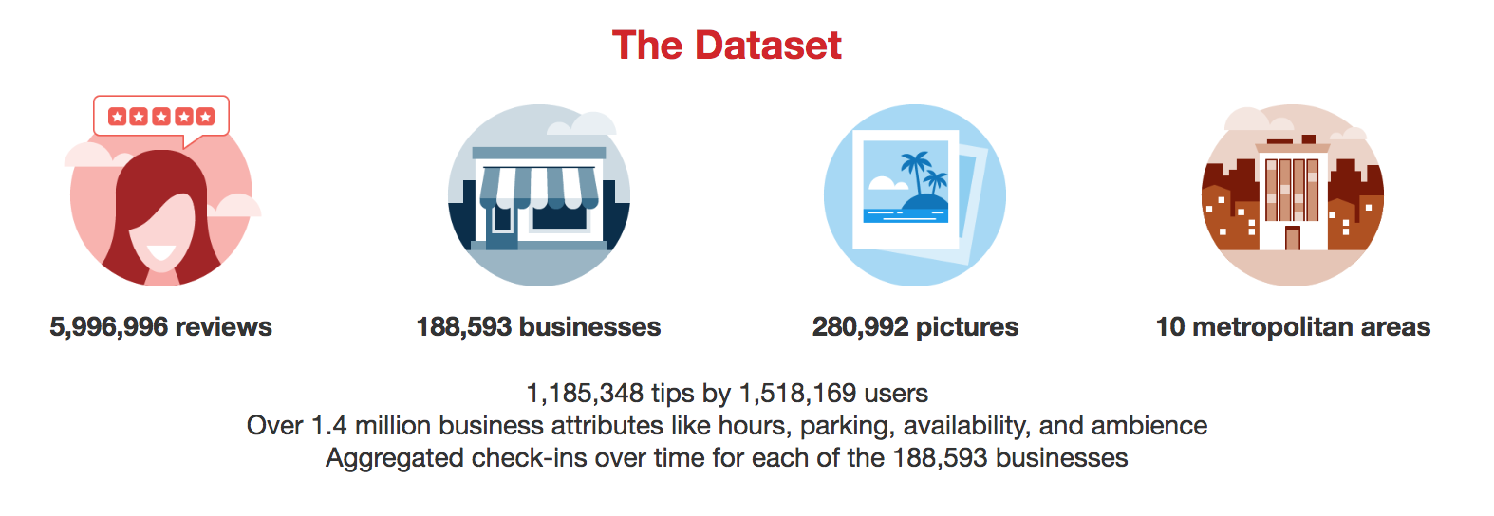
The Yelp Dataset
Yelp Dataset is from yelp challenge round 12 (accessed on 8/08/18)
https://www.yelp.com/dataset/challenge

Slide 3
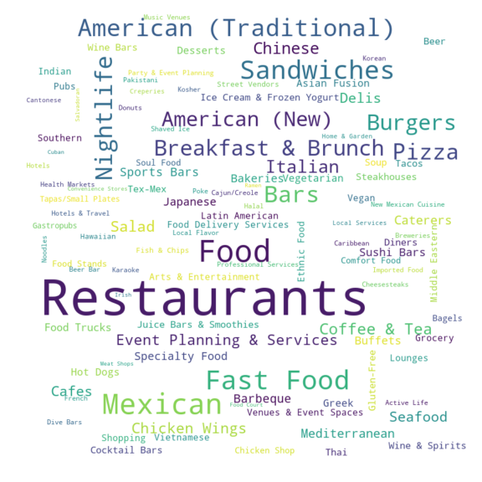
EDA
Subset of Dataset -
Focus on restaurants in Phoenix,
users with 5 or more restaurant reviews
Using business categories
len(df_sub.categories.unique())
2381
Split categories to words

Slide 4
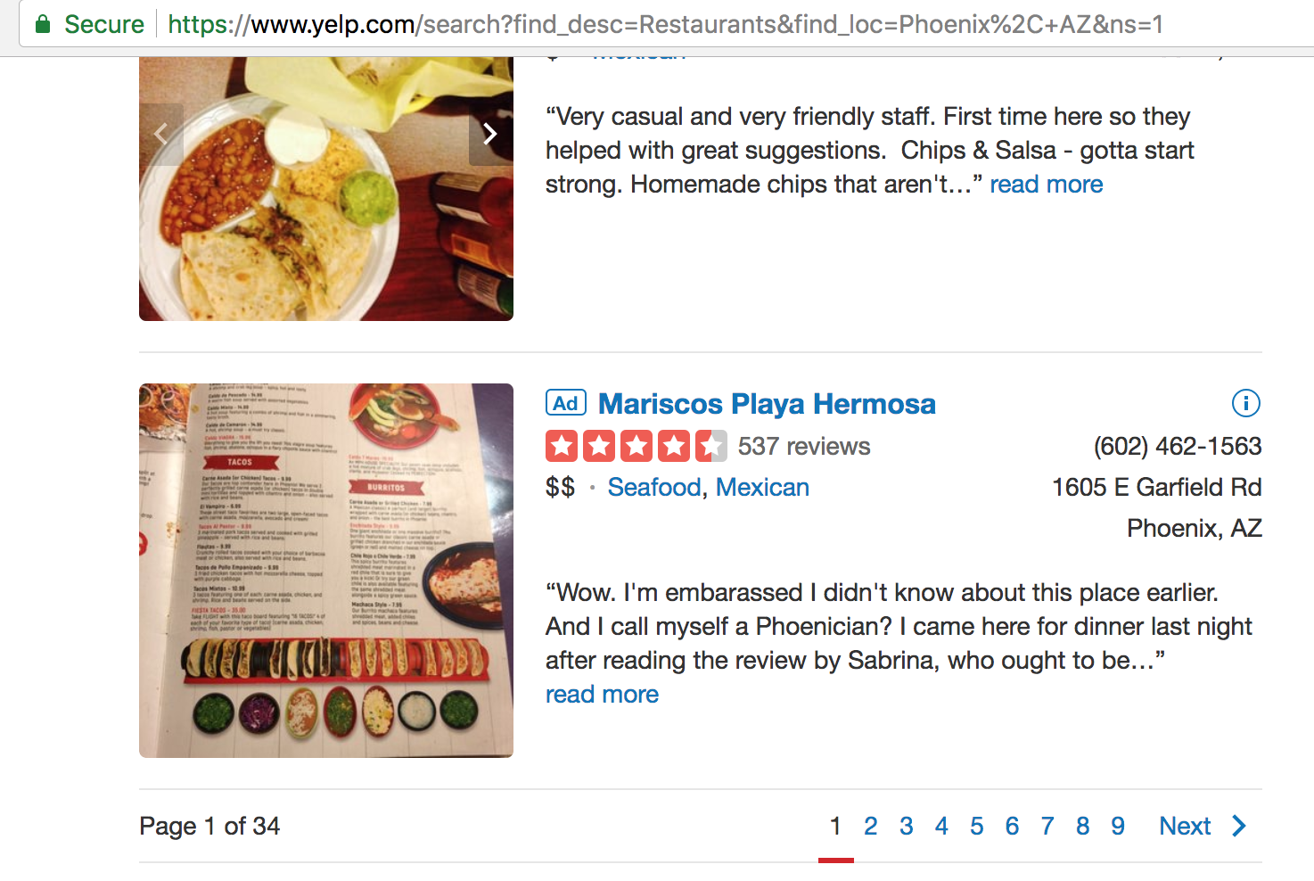
Why Not Search Directly From Yelp
Not personalized
Some restaurants the user likes may be in page 12...
Take some time to review through the content
Assumption
Restaurants reviewed by the user is the type of categories he/she likes to try
Limitation
Yelp API live data pull up to 1,000 restaurants for a given city to avoid connection error

Slide 5
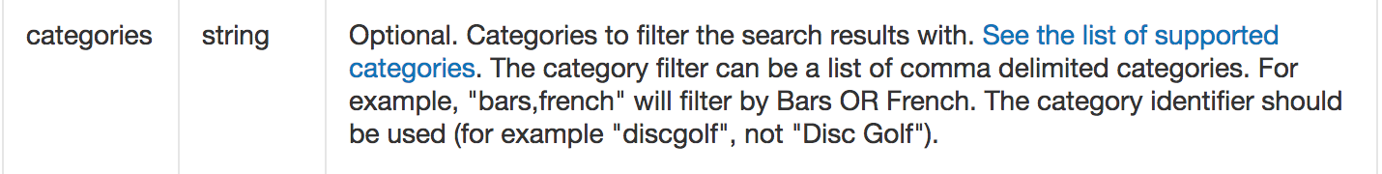
Challenge - Data structure inconsistent
Yelp dataset business categories is a string.
'Coffee & Tea, American (New), Breakfast & Brunch, Event Planning & Services, Fast Food'
Yelp API data business categories is a list of dictionaries with keys alias and title.
[{'alias': 'coffee', 'title': 'Coffee & Tea'},
{'alias': 'newamerican', 'title': 'American (New)'},
{'alias': 'breakfast_brunch', 'title': 'Breakfast & Brunch'},
{'alias': 'eventservices', 'title': 'Event Planning & Services'},
{'alias': 'hotdogs', 'title': 'Fast Food'}]

Slide 6
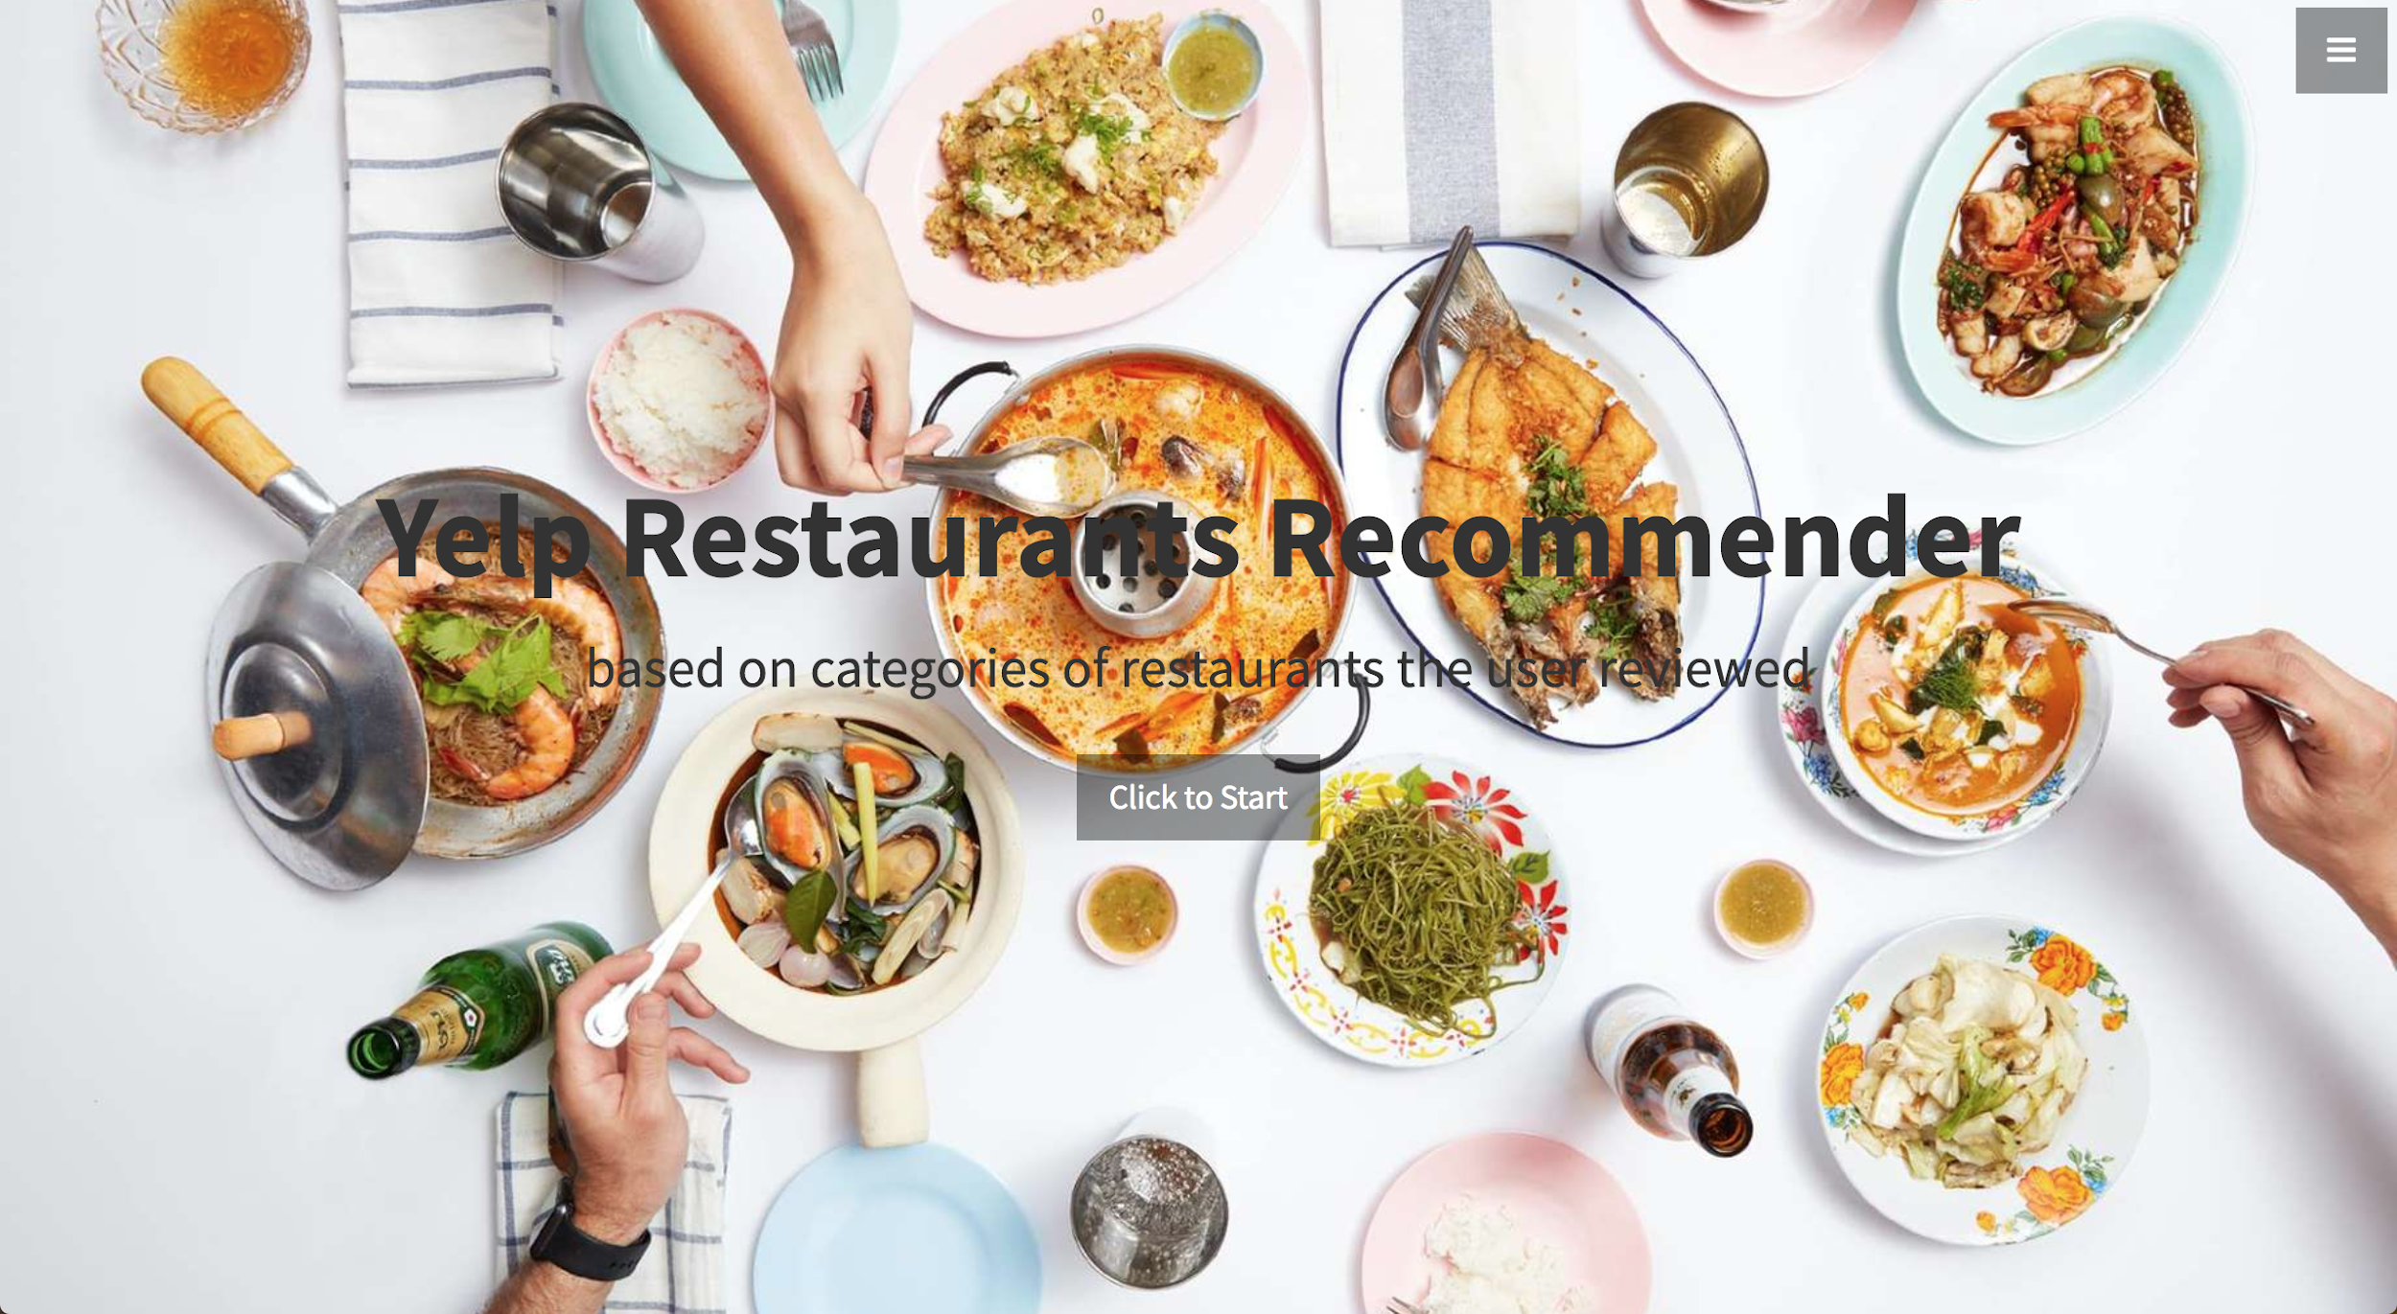
Web app by Flask - Starter page
AWS EC2 link
Some UserID to try:
--Nnm_506G_p8MxAOQna5w
--2HUmLkcNHZp0xw6AMBPg
-0IiMAZI2SsQ7VmyzJjokQ

Slide 7
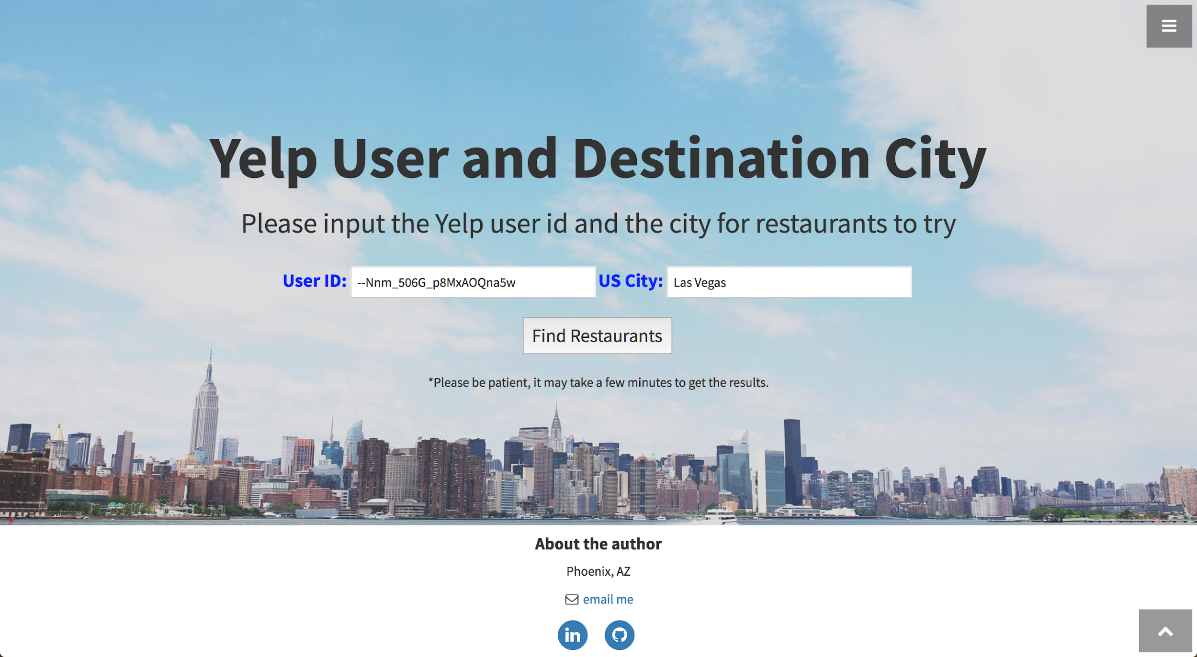
Input page
Using User ID to get local data from MongoDB, find most common words from categories of restaurants reviewed by this user.
Using Yelp API to retrieve live business data from Yelp for a given location.

Slide 8
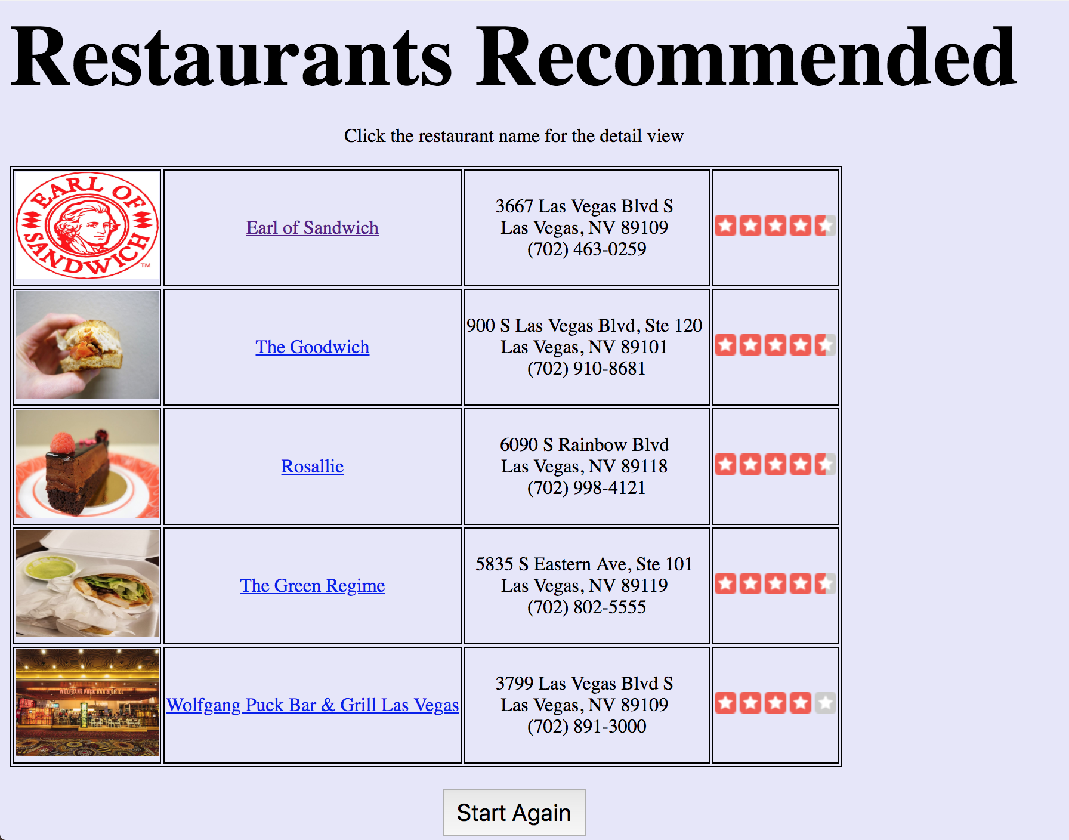
Recommender page
Get upto 5 restaurants (Yelp live data) whose categories contain the top 3 words from the categories of restaurants (MongDB) reviewed.
Typical image, name, address & phone, overall rating stars
Click restaurant name open a new window for the detail view.

Slide 9
Questions?

